Slide 1
IPv6: lurking in the dark, for a long long time

Slide 2
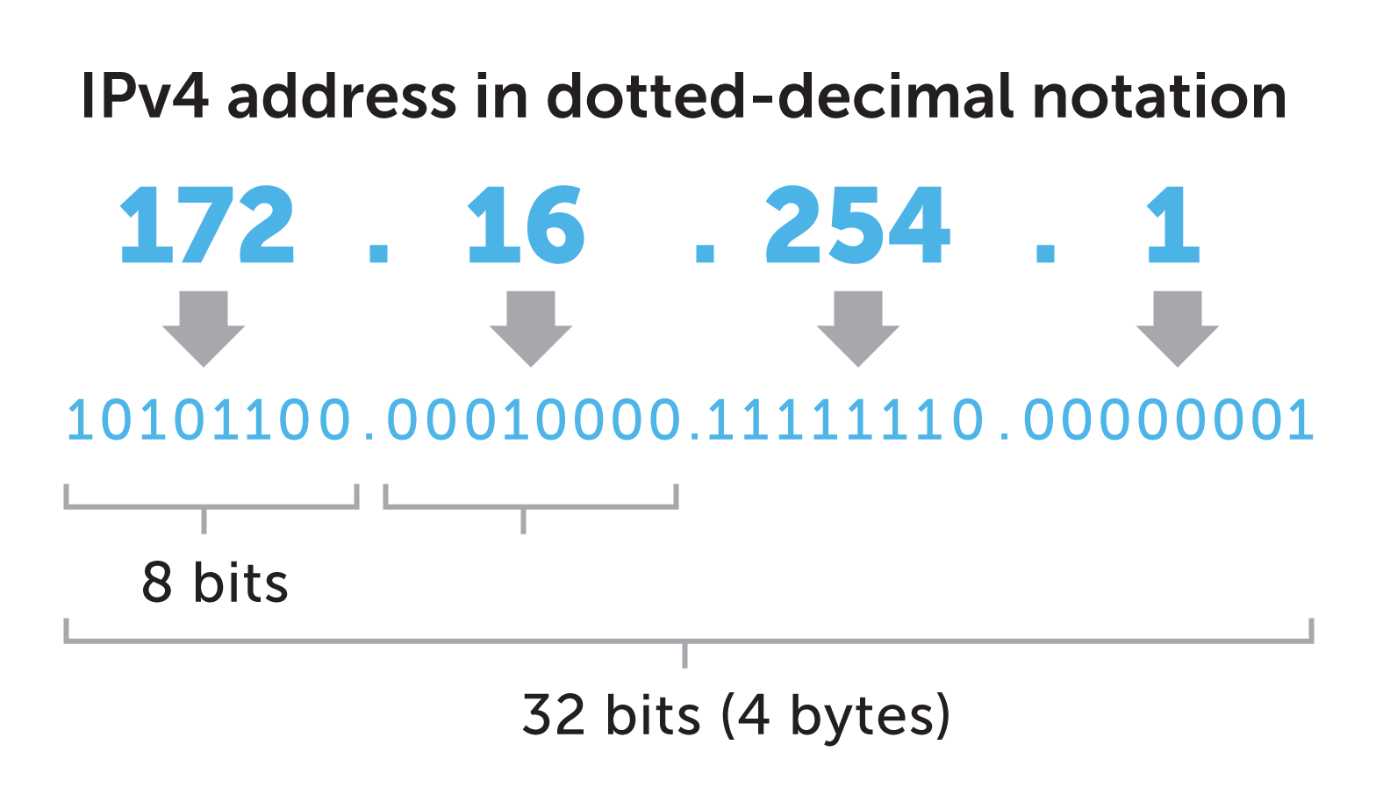
IPv4 and why we needed an upgrade…
To be able to communicate, each of the participating entities must have a unique identifier. In the case of computer networks, the IP address serves this purpose.
For most part of the internet’s history, IPv4, a 32-bit address integer, divided into 4 blocks of 8 bits each, has been used as the standard protocol to assign IP addressed to nodes.
However…
It can uniquely identify 2^32 = 4.3 billion nodes only
of which 18 million IPs are allocated for private use only.
So with the boom of devices capable of connecting to the internet on a planet of 7B people, 4.3B address quickly got exhausted.
Subnetting started and things got a bit complicated.
Hence, and upgrade was needed.

Slide 3
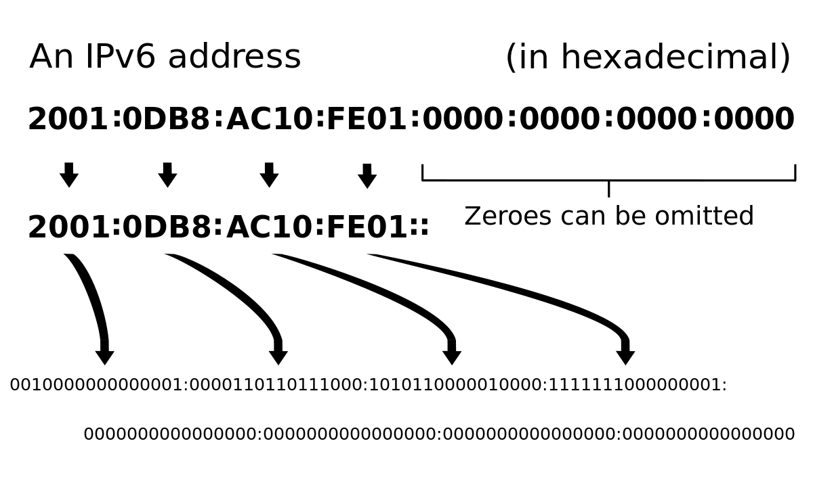
IPv6 comes into the picture
IPv6 uses 128-bit addresses, theoretically allowing 2^128, or approximately 3.4×10^38 total addresses, which is way more than what we need right now.
IPv6 addresses are represented as eight groups of four hexadecimal digits each, separated by colons.
Which makes each block have the size 16 bits.

Slide 4
Advantages of IPv6 over IPV4

Slide 5
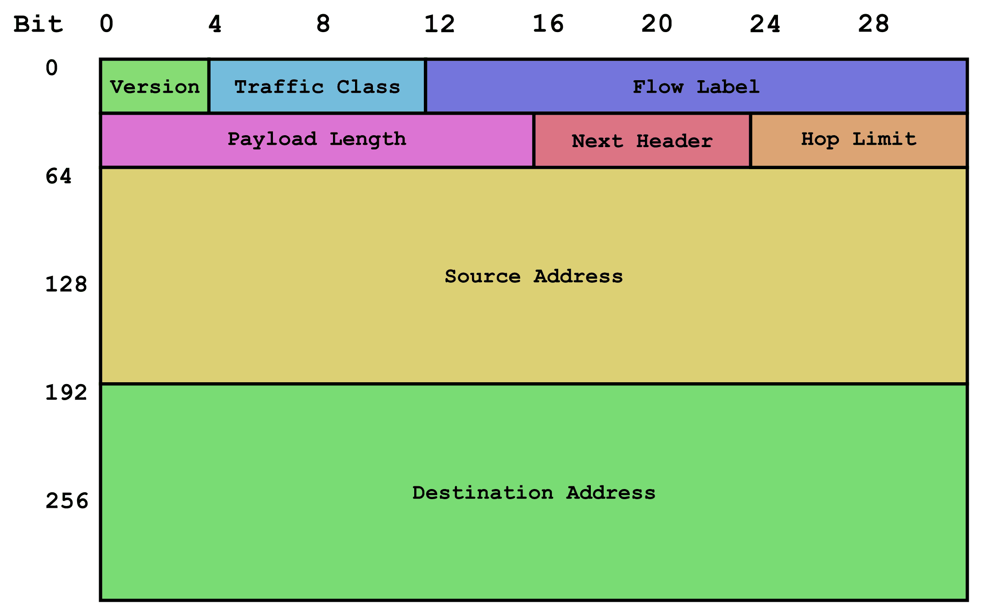
Larger address space
The main advantage of IPv6 over IPv4 is its larger address space.
The longer addresses simplify allocation of addresses, enable efficient route aggregation, and allow implementation of special addressing features.
The standard size of a subnet in IPv6 is 2⁶⁴ addresses, about four billion times the size of the entire IPv4 address space.
Thus, actual address space utilization will be small in IPv6, but network management and routing efficiency are improved by the large subnet space and hierarchical route aggregation.

Slide 6
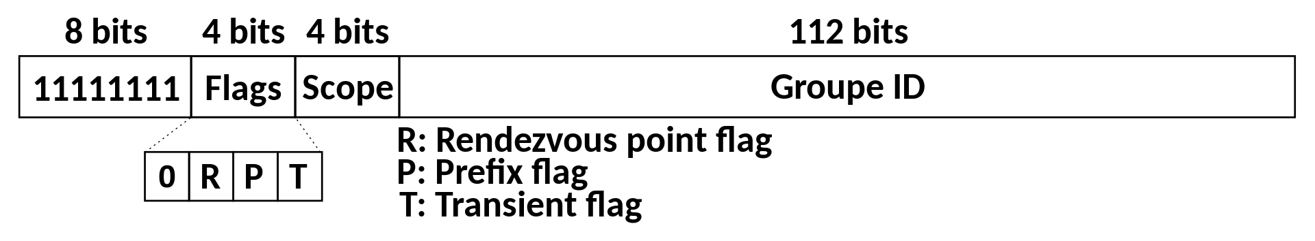
Multicasting
Multicasting, the transmission of a packet to multiple destinations in a single send operation, is part of the base specification in IPv6. In IPv4 this is an optional (although commonly implemented) feature.
IPv6 does not implement traditional IP broadcast, i.e the transmission of a packet to all hosts on the attached link using a special broadcast address, and therefore does not define broadcast addresses.
In IPv6, this is achieved by sending a packet to the link-local all nodes multicast group at address ff02::1, which is analogous to IPv4 multicasting to address 224.0.0.1
IPv6 also provides for new multicast implementations, including embedding rendezvous point addresses in an IPv6 multicast group address, which simplifies the deployment of inter-domain solutions

Slide 7
Stateless address autoconfiguration (SLAAC)
IPv6 hosts configure themselves automatically. Every interface has a self-generated link-local address and, when connected to a network, conflict resolution is performed, and routers provide network prefixes via router advertisements.
The design of IPv6 intended to re-emphasize the end-to-end principle of network design by rendering network address translation obsolete.
Therefore, every device on the network is globally addressable directly from any other device.
A stable, global IP address might be privacy concern as its activities can be traced throughout the internet.
To address this, SLAAC protocol includes what are typically called "privacy addresses" or, more correctly, "temporary addresses“.
A typical consumer device generates a new temporary address daily and will ignore traffic addressed to an old address after one week.
Temporary addresses are used by default by Windows since XP SP1, macOS since MacOS10.7, Android since 4.0, and iOS since version 4.3.

Slide 8
IPsec
Internet Protocol Security (IPsec) was originally developed for IPv6, but found widespread deployment first in IPv4, for which it was re-engineered.
IPsec was a mandatory part of all IPv6 protocol implementations and Internet Key Exchange (IKE) was recommended, but with updates the inclusion of IPsec in IPv6 implementations was downgraded to a recommendation because it was considered impractical to require full IPsec implementation for all types of devices that may use IPv6.
However, the IPv6 protocol implementations that do implement IPsec need to implement IKEv2 and need to support a minimum set of cryptographic algorithms. This requirement will help to make IPsec implementations more interoperable between devices from different vendors

Slide 9
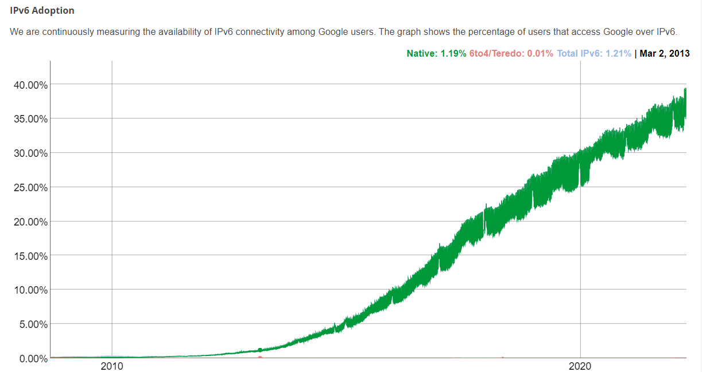
“Business” booming?

Slide 10
Slow adoption rate…but why?
Doesn't include a checksum in the header. IPv6 no longer has a header checksum to protect the IP header, meaning that when a packet header is corrupted by transmission errors, the packet may be delivered incorrectly.
IPv4 and IPv6 machines cannot communicate directly to each other.
The process of making the switch to IPv6 from IPv4 is slow and tedious.
Understanding IPv6 subnetting can be difficult on its own.
Because the header is of fixed length in IPv6, options cannot be tagged onto the IP header as in IPv4.
Uses Flow Label field to identify packet flow for QoS handling by router.
Allows the host to send fragments packets but not routers.

Slide 11
Muchas Gracias.

